Slide 1
Lecture-16

Slide 2
Contents
DevOps Continuous Monitoring
DevOps Monitoring Types
Monitoring Tools
Nagios
Architecture of Nagios

Slide 3
DevOps Continuous Monitoring
Continuous Monitoring is an automated process that leverages specialized software tools to empower DevOps teams with enhanced visibility of application performance, security threats, and compliance concerns across the entire DevOps pipeline.
It provides a comprehensive, real-time view of the status of production applications, services, and infrastructure. Real-time streaming, historical replay, and visualization are the crucial aspects of application and service monitoring.

Slide 4
DevOps Monitoring Types
Continuous monitoring in DevOps comes in four forms:
  Infrastructure monitoring
  Application monitoring
  Network monitoring

Slide 5
Infrastructure Monitoring
Infrastructure Monitoring OR Server Monitoring involves detecting, tracking, and compiling real-time data on the health and performance of the backend components of your DevOps tech stack.
Those components include servers, databases, virtual machines, and containers, among other computing components in a system.
It provides statistics on RAM consumption, CPU loads, and disk space left. It is helpful in aggregating data from virtual server systems for cloud-based scenarios.

Slide 6
Application Monitoring
Application Monitoring -
  Tools and processes for monitoring the health and performance of released applications in a production environment.
  It measures how well a service is performing overall. These tools query the server on their own and keep track of metrics such as response time and completion. It is essential to ensure that application performance issues are promptly detected and diagnosed so that services can function as intended.

Slide 7
Network Monitoring
Network Monitoring -
  Tools and processes for monitoring network activity and components, such as servers, firewalls, routers, and switches, as well as detecting security threats across the network.
  It examines the data flowing in and out of your computer network. Using this monitoring tool, you can keep track of incoming requests and responses across all components, from switches to firewalls and servers.

Slide 8
Continuous Monitoring Steps
Define: Develop monitoring strategy
Establish: How performing you are going to monitor it
Implement
Analyze data and report performing
Respond
Review and update

Slide 9
DevOps Monitoring Tools
Top 10 DevOps Monitoring Tools
  Librato
  Splunk
  Nagios
  Zabbix
  Sematext
  Sensu
  AppDynamics
  Kibana
  Raygun
  New Relic

Slide 10
Nagios
Nagios is one of the widely-used open-source DevOps tool for continuous monitoring.
This software application mainly provides the services of monitoring and alerting for switches, applications, and servers inside the DevOps culture.
Nagios offers server, application, and network monitoring capabilities. It can track any device with an IP address.
It also monitors multiple server services, including SMTP, IPMI, FTP, LDAP, POP, DNS, IMAP, HTTP, and Proxy under Linux and Windows.
It enables application monitoring as well, including CPU, swap, memory, and load analysis.
Nagios is a free download, has a simple web interface, and supports over 5,000 server monitoring integrations.

Slide 11
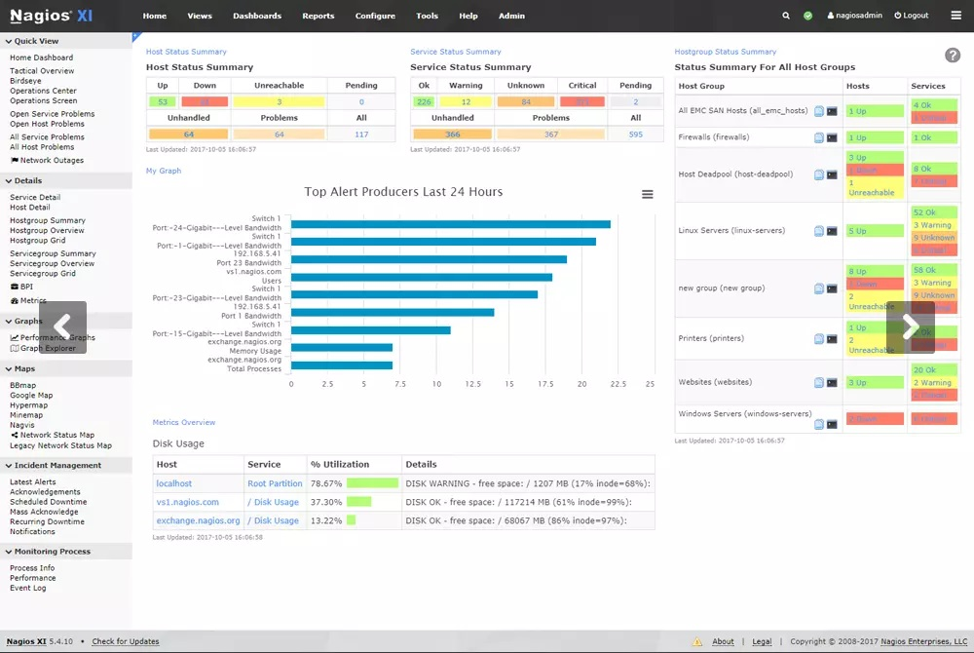
Nagios (Cont.)

Slide 12
Nagios Need for Continuous Monitoring
Continuous Monitoring Tools resolve any system errors ( low memory, unreachable server etc. ) before they have any negative impact on your business productivity.
Important reasons to use a monitoring tool are:
  It Detects all types of network or server issues
  Helps you to find the root cause of the problem which allows you to get the permanent solution to the problem
  Active monitoring of your entire infrastructure and business processes
  Allows you to monitors and troubleshoot server performance issues
  Helps you to plan for infrastructure upgrades before outdated systems create failures
  You can maintain the security and availability of the service
  Automatically fix problems in a panic situation

Slide 13
Nagios Variants
Two variants of Nagios:
Nagios Core: The Nagios is also known as a Nagios Core. It is an open-source product. It is released on 1st March in the year 2002.
Nagios XI: It is an extended version of Nagios. It provides advanced components and tools for monitoring. This variant needs a software license.

Slide 14
Nagios Features
Oldest and latest
Good log system
Informative and attractive web interface
Automatically send alert if condition changes
  Warning, critical etc.

Slide 15
Nagios Features (Cont.)
You can develop custom plug-ins that match your requirements and check the most critical production environment requirements.
The documentation on the Nagios website is rather comprehensive, and you may use it for any specific reference.
It has a feature that allows you to set up services to ping devices in an organization.

Slide 16
Architecture of Nagios
The architecture of Nagios is built on the basis of server-client architecture.
The server of Nagios usually run on a host and the plugins run on the remote server/ or remote host which are to be monitored.
The plugins of Nagios collect the useful data and send them to the process scheduler, which displays the information over the graphical user interface (GUI).
Nagios sends a signal through a process scheduler to run the plugins on the local/remote hosts/servers.
Plugins collect the data (CPU usage, memory usage etc.) and sends it back to the scheduler.
Then the process schedules send the notifications to the admin/s and updates Nagios GUI.

Slide 17
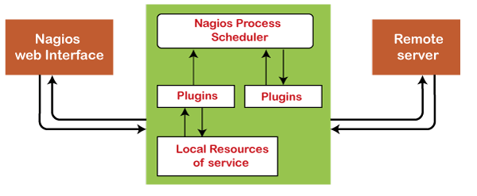
Architecture of Nagios (Cont.)
Scheduler
GUI
Plugins

Slide 18
Nagios Architecture Components
Scheduler-
  The scheduler is the server part of the Nagios system. This component checks the plugins at regular interval and according to their results perform some action.
GUI -
  It is a user interface of the Nagios system, which is displayed on the web pages generated by the CGI.
  GUI have buttons of Red or Green colors, graph, sound, etc.
  The GUI Green button becomes red, when the plugins returns an error or warning.

Slide 19
Nagios Architecture Components (Cont.)
Plugins -
  Plugins is a component of the Nagios system, which is configurable by the users. This component detects the services and return the results to the server of Nagios.

Slide 20
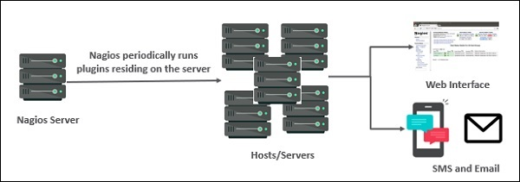
Nagios Architecture Components (Cont.)

Slide 21
Types Nagios Checking
Active Checks:
  Active checks are initiated by the Nagios process and execute on a regularly scheduled basis after they are started. Nagios executes plugins and passes the information about what needs to be checked in order to monitor remote hosts and services.
Passive Checks:
  Passive checks are initiated and performed by external applications/processes. Passive check results are then submitted to Nagios for further processing The main difference between active and passive checks is that active checks are initiated and performed by Nagios, whereas passive checks are performed by external applications.

Slide 22
Types of Nagios Plugins
Official Nagios Plugins − There are 50 official Nagios Plugins. Official Nagios plugins are developed and maintained by the official Nagios Plugins Team.
Community Plugins − There are over 3,000 third party Nagios plugins that have been developed by hundreds of Nagios community members.
Custom Plugins − You can also write your own Custom Plugins. There are certain guidelines that must be followed to write Custom Plugins.

Slide 23
Nagios Plugins
NRPE
  The Nagios daemon which run checks on remote machines in NRPE (Nagios Remote Plugin Executor).
  It allows you to run Nagios plugins on other machines remotely. You can monitor remote machine metrics such as disk usage, CPU load etc.
  It can also check metrics of remote windows machines through some windows agent addons.

Slide 24
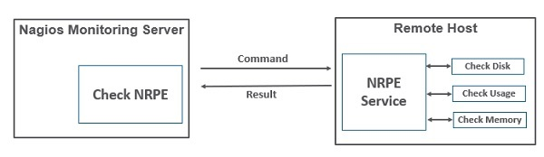
Nagios Plugins (Cont.)
CheckBySSH
  It is work as NRPE-Agent and installed on remote-server or client-side
  It is use to communicate with server and updated about client status

Slide 25
Continuous Feedback Phase

Slide 26
Continuous Feedback
Continuous feedback is essential to ascertain and analyze the final outcome of the application. It sets the tone for improving the current version and releasing a Better Version based on stakeholder feedback.
The overall process of app development can only be improved by analyzing the results from the software operations.
Feedback is nothing but information gathered from the client’s end.
Here, information is significant, as it carries all the data about the performance of the software and its related issues. It also contains suggestions given by end users of the software.

Slide 27
Continuous Feedback (Cont.)
During this phase, customer behavior is evaluated regularly on each release to improve future releases and deployments.
Businesses can either opt for a structural or unstructured approach to gather feedback.
  In the structural approach, feedback is collected through surveys and questionnaires.
  In contrast, the feedback is received through Social Media platforms in an unstructured approach.

Slide 28
Continuous Feedback Tools
Pendo - is a product analytics tool used to collect customer reviews and insights.
Qentelli’s TED - is another tool used primarily for tracking the entire DevOps process to gather actionable insights for bugs and flaws.

Slide 29
Thanks
…?

